Slide 1
Machine Learning Approach to Raman Spectral Classification
Jesse Levine
Supervisor: Li-Lin Tay

Slide 2
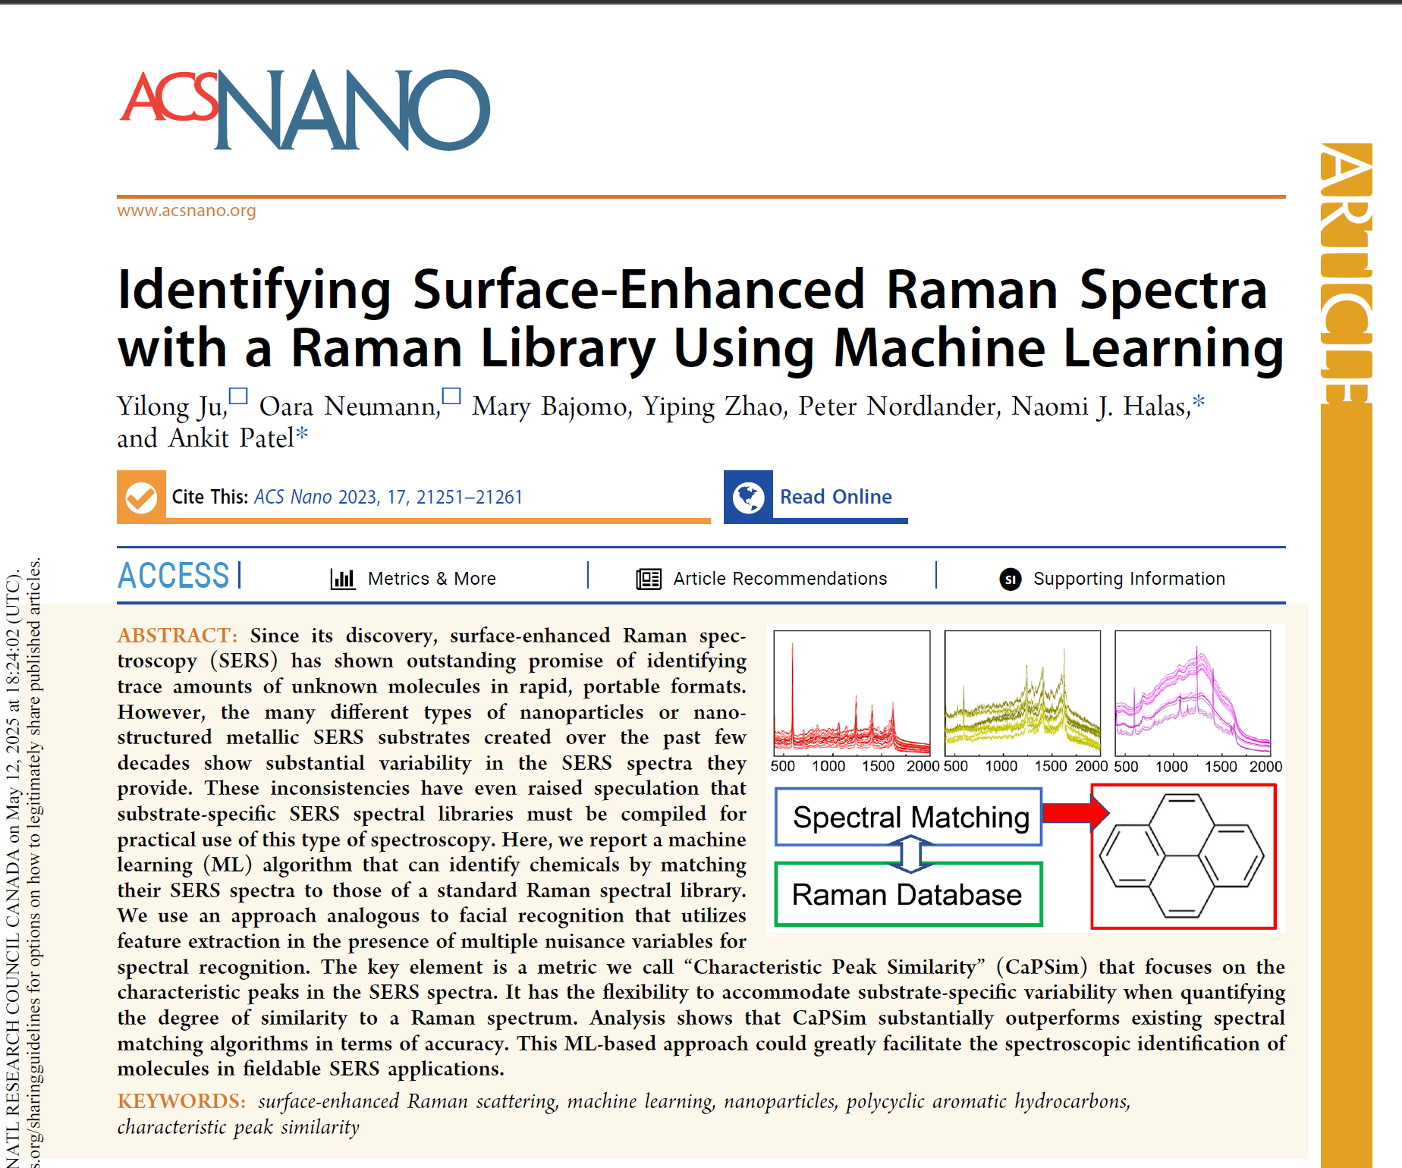
Goal
Core Problem: Can we reliably identify an unknown chemical from its Raman spectrum by matching it against a reference library?
Inspiration: Facial Recognition

Slide 3
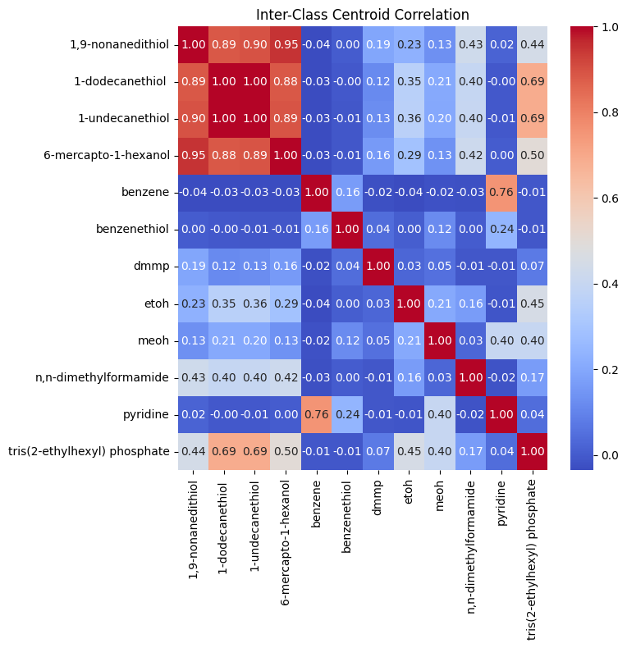
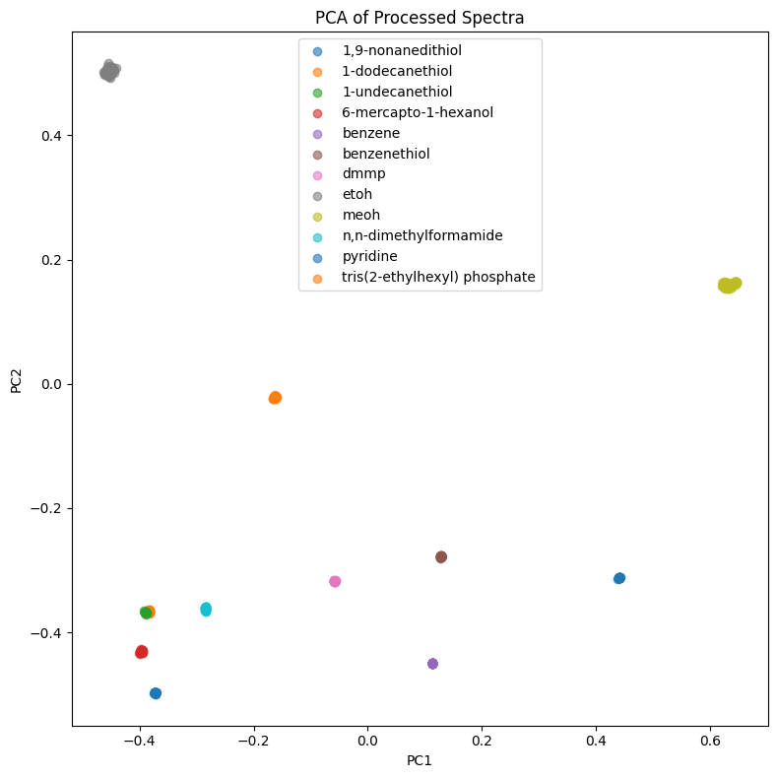
Initial Exploration: PCA

Slide 4
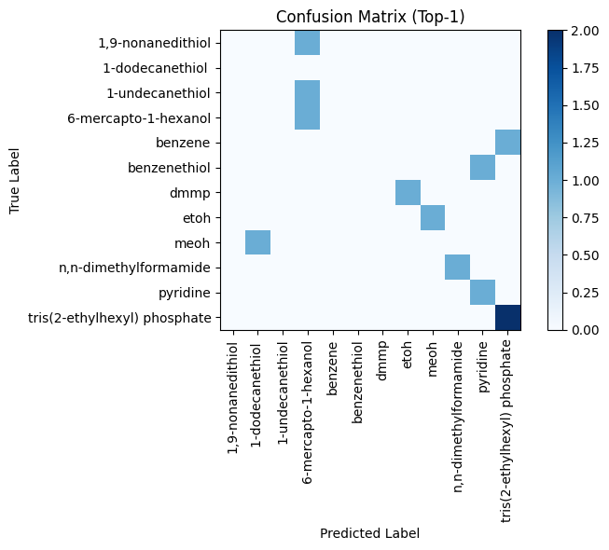
Characteristic Peak Similarity (CaPSim)
CaPE → Dot Product
Top 1: 41.67%
Top 2: 75%
Top 3: 83.33%

Slide 5
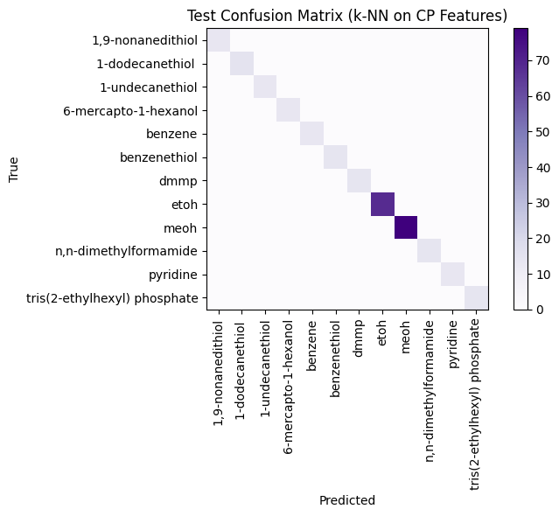
Improvement #1: CaPSim-kNN
Improvement: Replace dot-product with kNN classifier
Top 1: 100%

Slide 6
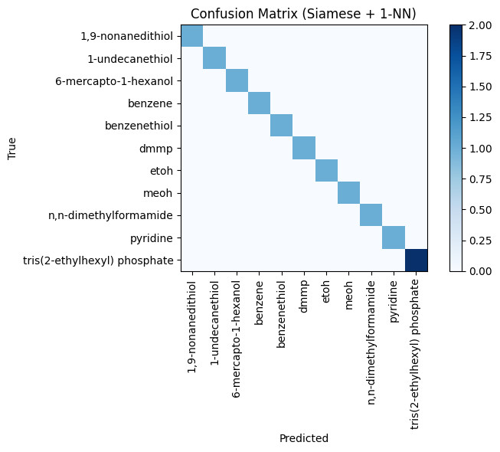
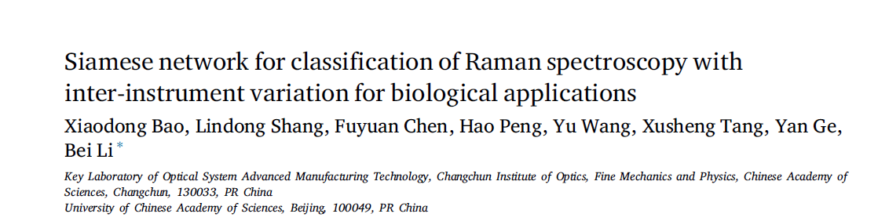
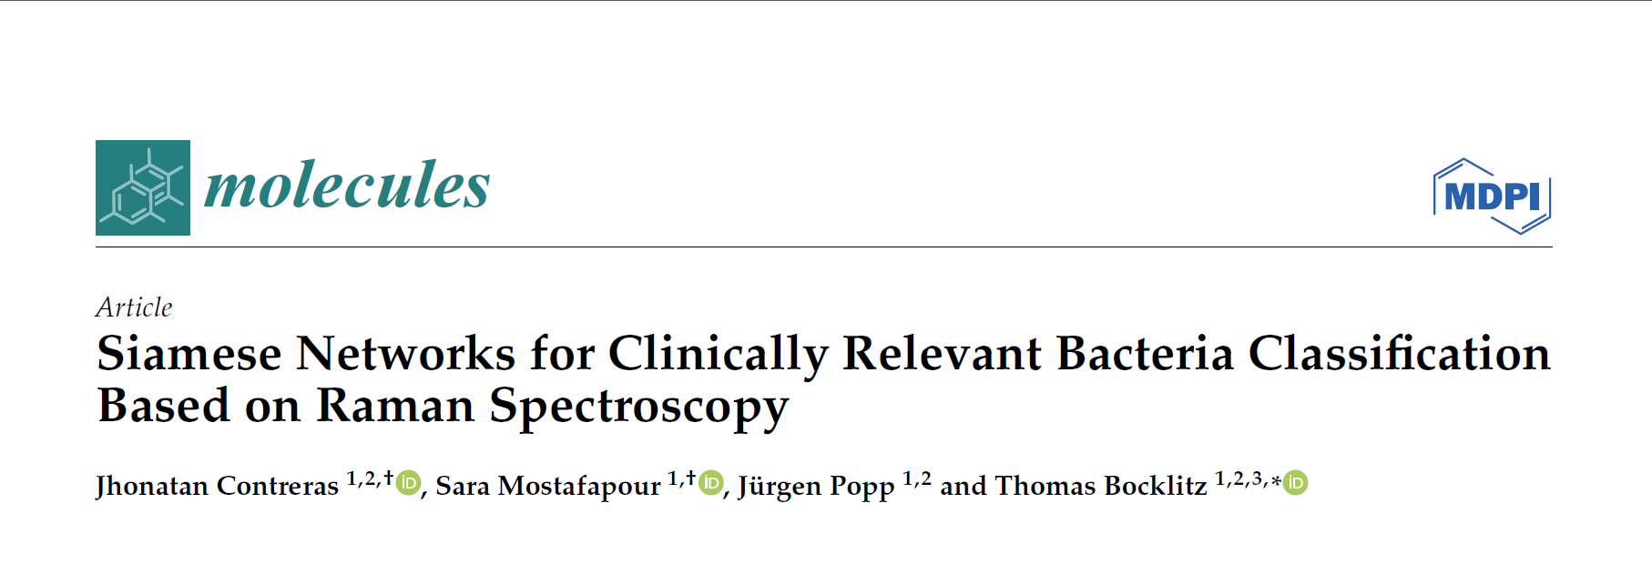
Improvement #2: Siamese Network

Slide 7
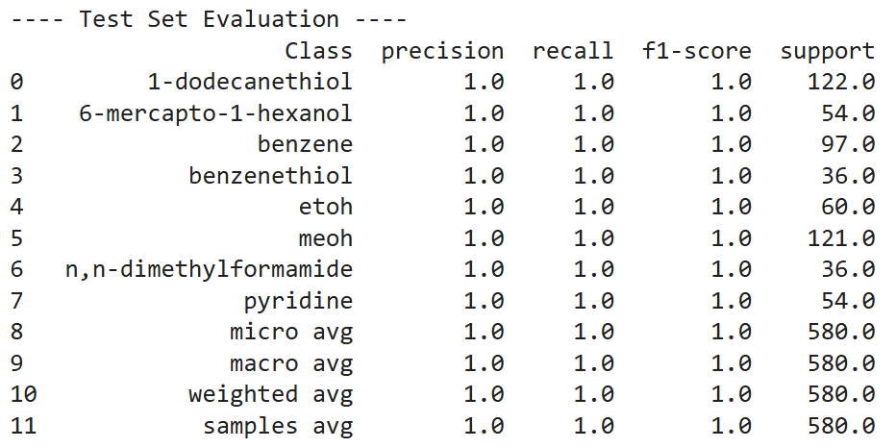
New Challenge: Mixtures
First Approach: Multilabel Classification
CaPSim-kNN
Limitation: Not generalizable to unseen mixtures
100% Accuracy

Slide 8


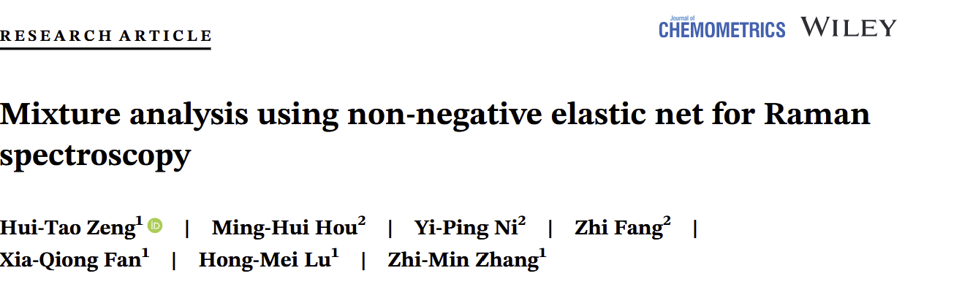
Mixtures 2.0 - Deconvolution+Meta-Classification
Non-Negative ElasticNet (Regularized NNLS) to “unmix”
Output: “Weights” vector estimating contribution of each pure chemical to mixture
Meta-Classification
Train meta-classifier → “Present” Or “Absent”
Test Set F1 Score: ~94%

Slide 9
Current rabbit hole
SERS classification from pure Raman
Quantification + Classification

